Slide 1



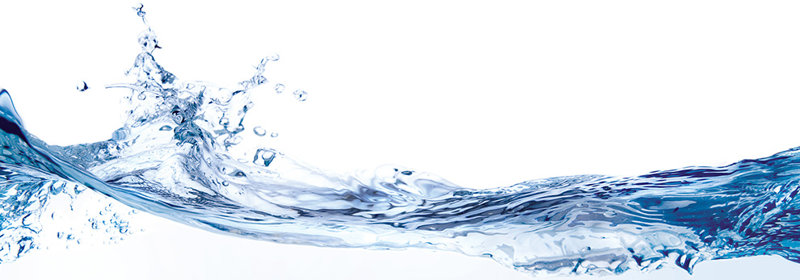

Slide 2
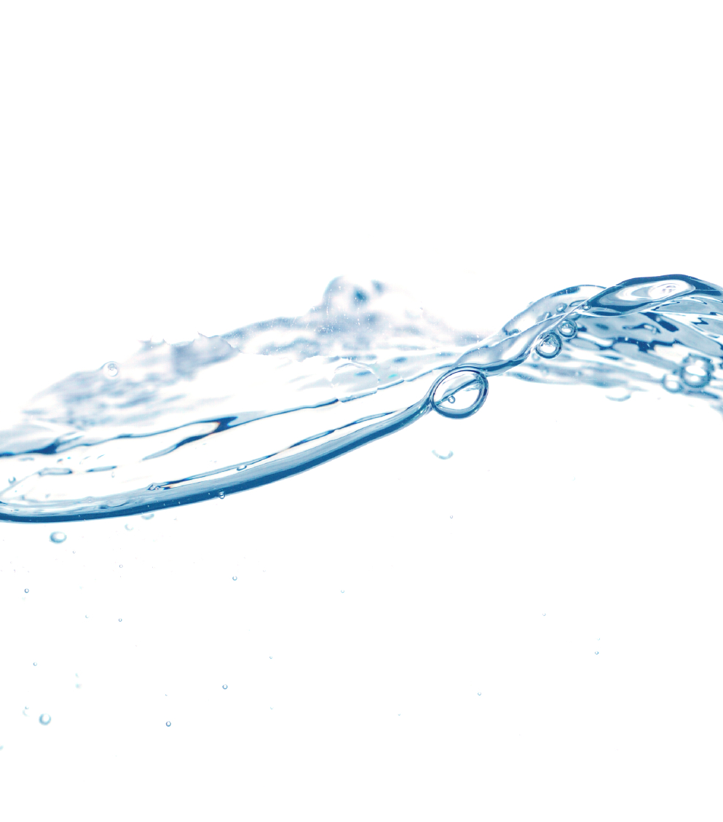
Do you ever think about water?
Notes:
When you turn on the faucet in the morning to brush your teeth, do you ever think about where that water came from?
Or the journey it took to get to your faucet?
What about the people it took to get it to you?
What about after the flush? Ever think about what happens after that?
When it rains where does all the rainwater go?
It’s not magic. It takes an enormous about of infrastructure and engineering and workforce to get that water to you and take it away after you have used it.
It is easy for us to take water for granted in our country but Billions of people across the globe struggle for access to safe drinking water and/ or adequate sanitation.

Slide 3
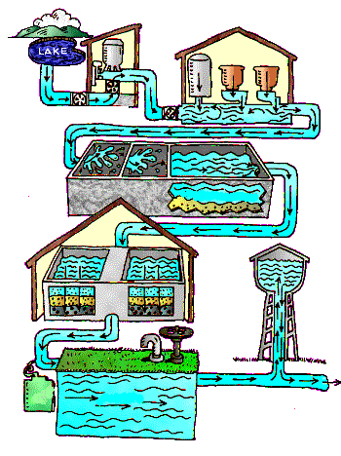
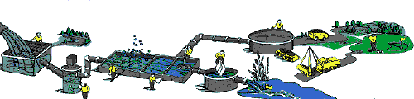
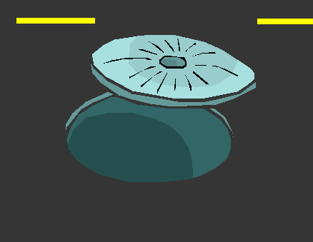
The Water Use Cycle
Water Mains
Lakes & Rivers
Water Treatment Plant
Sewer Treatment Plant
Sewer Mains
House
Notes:
Walk through the Water Use Cycle. (Click for each step)
Do you know where your drinking water comes from? (Specify local source- Chattahoochee River, etc..)
From the ________ source, it then goes to a water treatment plant where it is filtered, cleaned and tested for quality.
Once the raw water is purified, it goes through a long network of underground pipes called water mains.
It travels miles and miles until it reaches your house, when you turn on the tap. Once you use the water and it goes down the drain, what happens to it?
It goes into the wastewater collection system/ sanitary sewer system. This is a separate network of underground pipes that transports the wastewater away from homes and businesses.
The wastewater is transported to a wastewater treatment plant where it is filtered, cleaned and tested. Once we clean it, where does it go? Anyone know???
It goes back into our lakes and rivers so it can be used again. Because we have a limited amount of freshwater on earth, we must use it over and over again. It is the ultimate in recycling.
This is where WATER PROFESSIONALS come in. We are the people who make this whole cycle happen. The treatment plants, all of the water and wastewater mains, fire hydrants, water meters, manholes, water tanks and everything in between. We are responsible for all of that! And it is a pretty big job.

Slide 4

Purpose…
Make a difference in your world.
Protect…
The environment & your community.
Pathway…
To your future.
Purpose… Make a difference in your world.
Protect…The environment & your community
Pathway…To your future
Notes:
Being a water professional is a pretty fantastic job.
Because……
There is purpose in what I do. When I get up everyday to go to work, I know that I have an important role in the lives of everyone in my community.
As a water professional, we protect the environment. By keeping our wastewater collection system working properly, we are protecting the environment from hazardous contaminants. We make sure that the wastewater gets probably transported and cleaned at the wastewater treatment plant before it is returned to water sources. This protects our lakes and rivers for recreation and to be used for drinking water. It also protects the animals and ecosystem surrounding our water sources.
There are lots of great career options in the water industry. No matter what your interests or educational goals are, you are likely to find a career path that appeals to you.

Slide 5
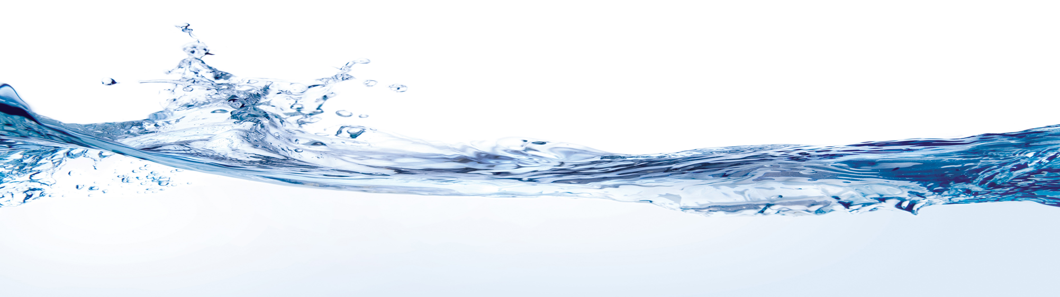
Career Tracks
Job examples
Employers
Operator
inspector
civil Engineer
GIS Coordinator
Laboratory Analyst
Environmental educator
Environmental compliance specialist
City & County Water Utilities
Engineering/ Consulting firms
State & Federal Regulatory Agencies
Nonprofit Groups
Construction contractors
Product Sales
Notes:
This is sketch of some of career opportunities as a water professional. Here we have a few examples of actual job titles in our industry and potential of employers who would hire those positions.
Job Examples in the water industry:
Operator (Treatment & System Operators in the field)
Inspector ( Construction or Compliance)
Civil Engineer (Design Infrastructure or Development Projects)
GIS Coordinator (Map & Analyze Geographic Infrastructure Data)
Laboratory Analyst (Collect & Monitor Water Quality Data)
Environmental educator (Teach others about the importance of water)
Environmental compliance specialist (Ensure customers are adhering to environmental regulations)
Examples of Employers in the water industry:
City & County Water Utilities – local water utilities responsible for the water use cycle we discussed earlier (Gwinnett County Water. Cobb Water, City of Atlanta, etc))
Engineering/ Consulting Firm- help design and manage infrastructure projects for utilities ~design treatment plants, water towers and pipe replacement projects)- (Jacobs, Arcadis, Brown & Caldwell)
State & Federal Regulatory Agencies – Specify and/ or enforce environmental law & policy (Environmental Protection Agency- Fed (EPA) or State Division (EPD)
Nonprofit groups – Promote environmental literacy and stewardship (Chattahoochee Nature Center, Fernbank Museum, Ga Nature Conservancy)
Construction Contractors- perform the construction aspect of infrastructure projects, build a new treatment plant or install new water pipes, etc (Ruby Collins, Archer Western, Wade Coots Contractors)
Product Sales- utilities and contractors have to purchase all of the materials, pumps and equipment they use (Templeton & Assoc, Adams Equipment, Ferguson Waterworks)

Slide 6
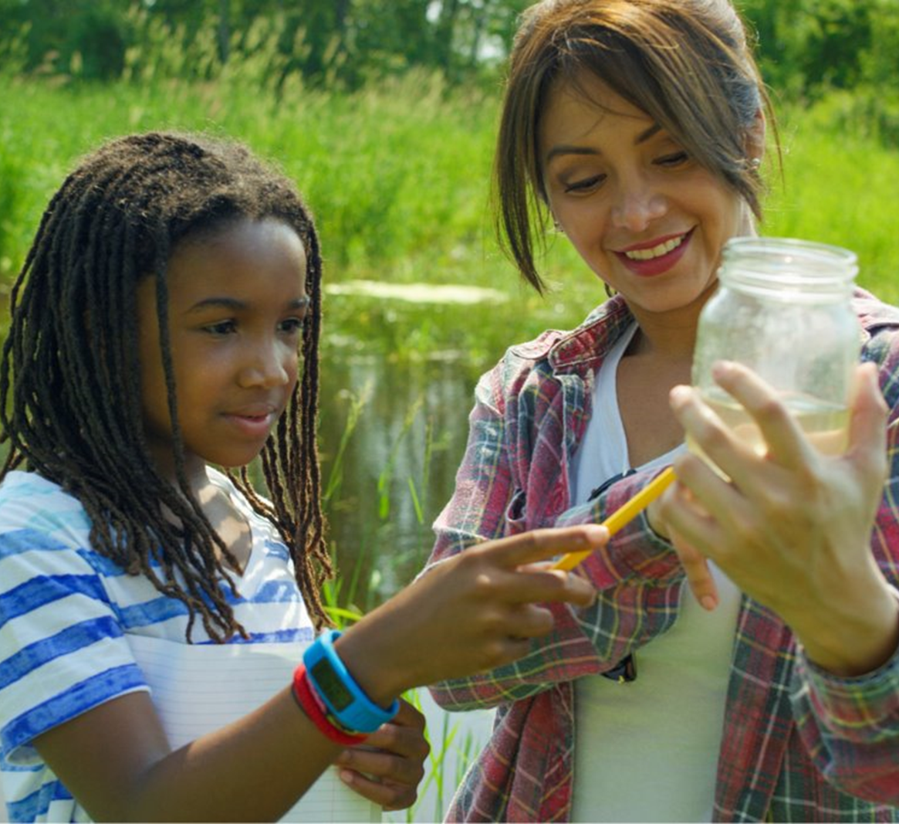
benefits
Variety of experience & education levels
Work Environment
Job Stability
Career Advancement Opportunities
Employer paid training & continuing education
Notes:
There are some pretty awesome benefits to working in the water industry:
There are a variety of career types and opportunities available. (H2Opportunity- Career Paths in Water Protection from GED to PhD). With so many options, you are bound to find one to fit your interest and education goals.
Work Environment- there are office jobs, lab jobs, field jobs and often a combination of office & field work. This is nice because it keeps things interesting and fresh.
Job stability in our industry is a really strong benefit.
Lots of opportunity to get experience, learn new skills and advance your career.
Many employers in the water industry will pay for job related training and continuing education.

Slide 7



Come help us
Make a difference!
Notes:
If you are thinking about your path for the future, consider a career in the water industry. Come help us make a difference!
H2Opportunity is a great place to find out more information about the water industry and water professionals.
Be sure to follow us on Twitter #H2OppportunityGA
and check out our website H2Opportunity.net for a ton of resources on internships, college programs, scholarships, job banks and a ton of other resources.

